Slide 1


GIT

Slide 2
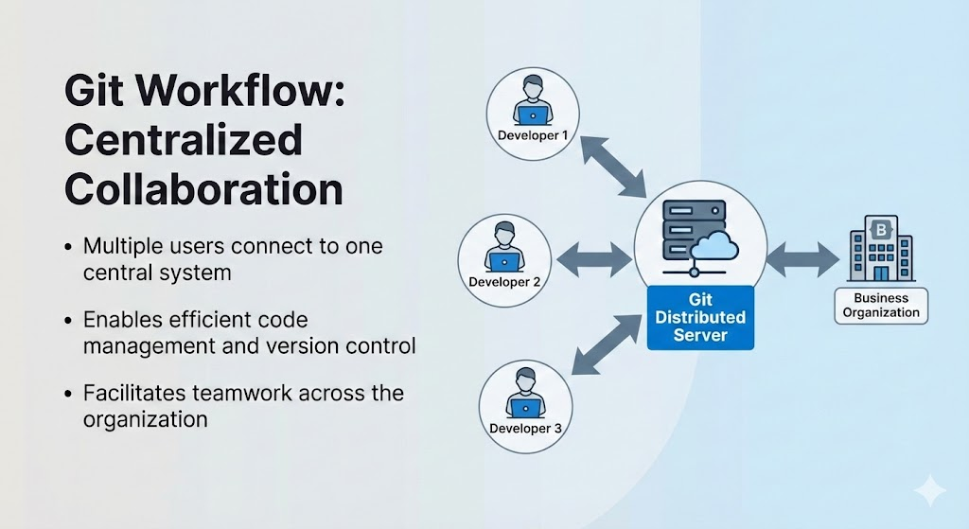
INTRODUCTION TO GIT
What is Git ?
  A distributed version control system for tracking changes in computer files.
  Primarily used for source code management (SCM) in software development.

Slide 3
KEY CAPABILITIES:
  Allows multiple developers to collaborate efficiently.
  Supports non-linear development through parallel branches.
FEATURES:
  Tracks history, creates backups, and is scalable.
  Free, open-source, and distributed.

Slide 4
WHY USE VERSION CONTROL?
PURPOSE:
TRACKING:
  Enables collaboration and creates a centralized location for code.
  Streamlines development and helps resolve conflicts.
  Tracks who made changes, what was changed, and when.
  Prevents concurrent work from conflicting.

Slide 5

CORE BENEFITS:
  Quality: Teams can review and improve each other's code.
  Acceleration: Faster branching, merging, and changes.
  Visibility: Better insight into release patterns and builds.

Slide 6
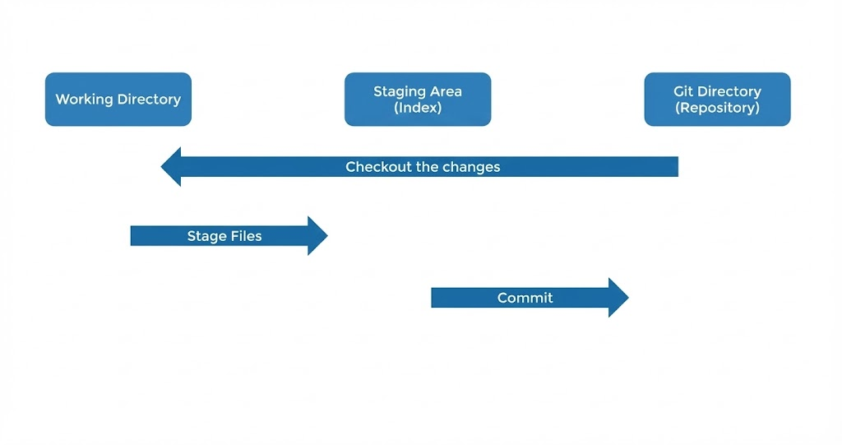
THE GIT WORKFLOW
THE THREE MAIN STATES:
  Working Directory: Where you modify and edit your files.
  Staging Area (Index): Where you organize snapshots of files before saving.
  Git Directory (Repository): Where snapshots are permanently stored.
THE CYCLE:
  Modify- Stage- Commit.

Slide 7
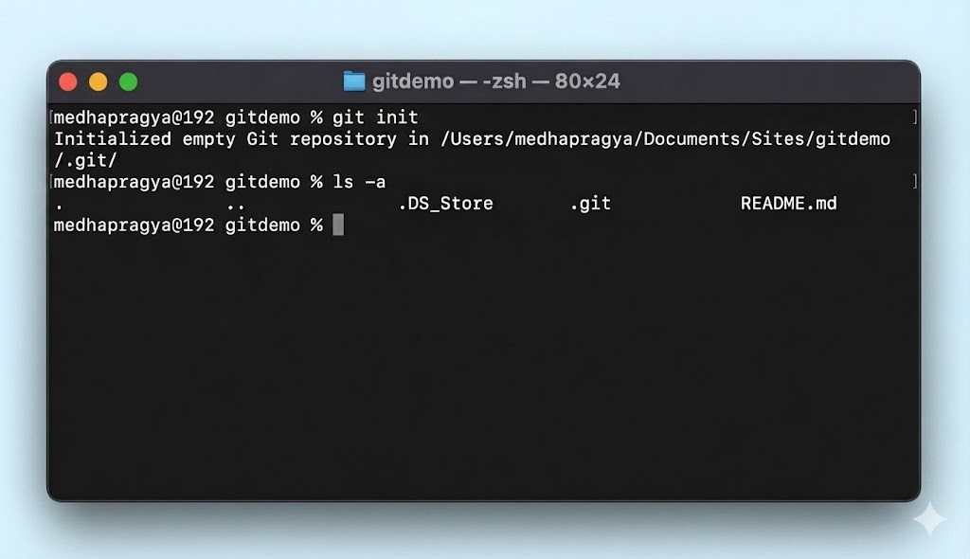
REPOSITORIES
THE CYCLE:
  A .git folder inside your project that tracks all project history.
INITIALIZATION:
  Command: git init.
  Initializes a new repository in your current folder.
BEHIND THE SCENES:
  The .git folder is hidden by default.
  To View: Use the command ls -a in the terminal.

Slide 8
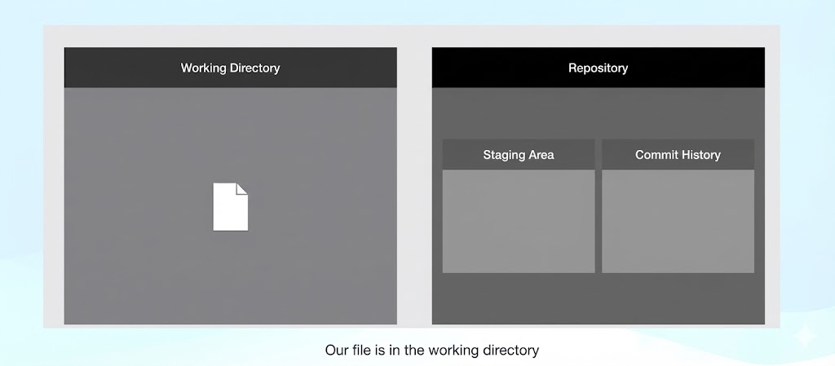
COMMIT IN GIT
Step 1 — Edit Files
Content:
  Action: Create or modify a file in the Working Directory.
Check Status:
  Command: git status.
  Shows differences between the working directory and staging area.
Result:
  New files appear as "Untracked"

Slide 9
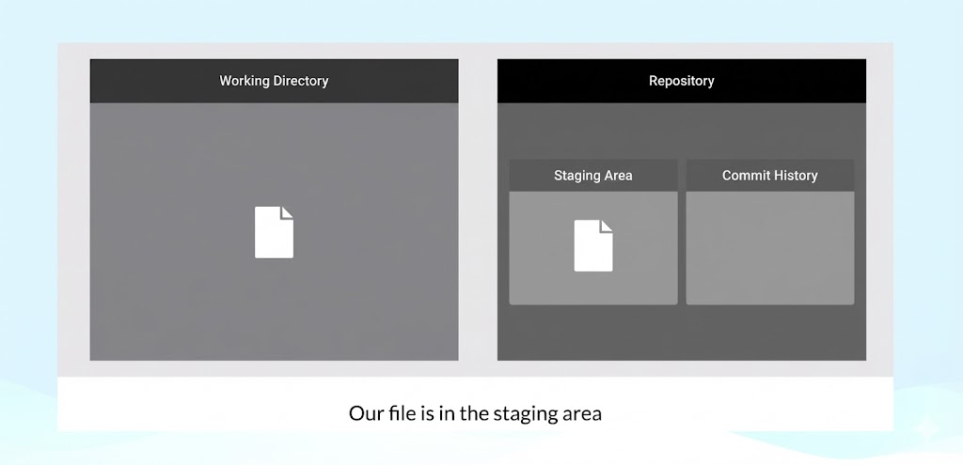
Step 2 — Add to Staging
  Action: Move files from Working Directory to the Staging Area.
  Command: git add <filename>.
  Result:
1. File is ready to be included in the next commit.
2. git status now shows "Changes to be committed"

Slide 10

Step 3 — Make the Commit
  Action: Permanently save the snapshot to the Repository.
  Command: git commit -m "Message".
  Verify History:
1. Command: git log.
2. Lists all commits in reverse chronological order.

Slide 11
THANK YOU

